Slide 1
Real Autobots and Decepticons (We are RAD)
Programming a Self-Configuring Robot

Slide 2
Overview

Slide 3
Problem Statement
Unaided organization of modules into a predetermined formation from random starting points.

Slide 4
Problem Statement
Random Starting Points
Detect Location
Find Goal State
Issue Orders
Determine Success

Slide 5
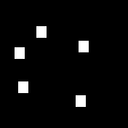
Problem Statement

Slide 6

Problem Statement

Slide 7
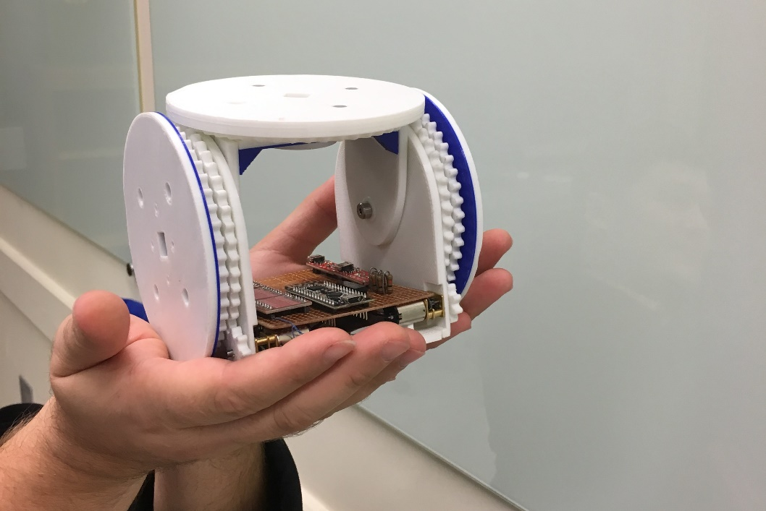

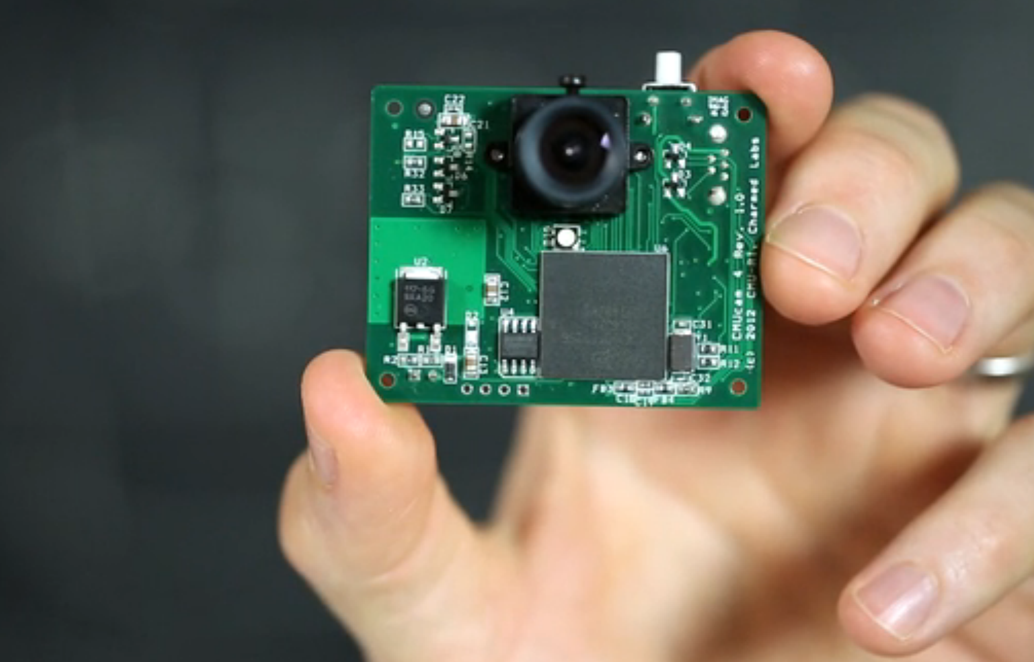
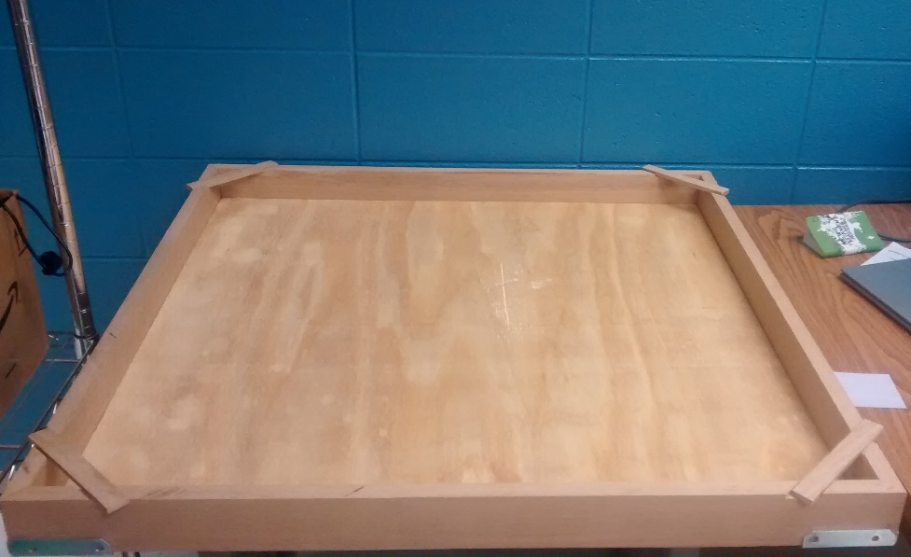

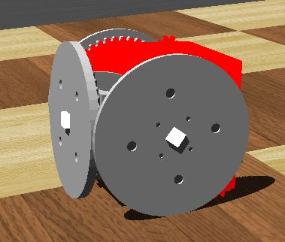
Materials

Slide 8

Approach

Slide 9
Design

Slide 10
Controller
Middle-man
Centralized
Composed of Levels
Separate Processes Per Level

Slide 11
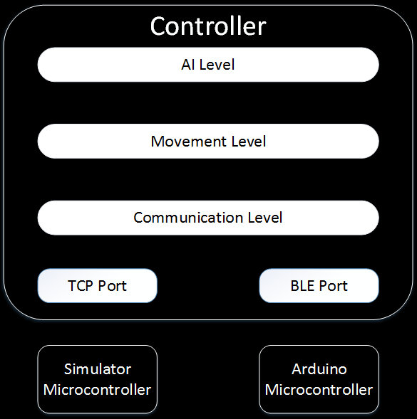
Design

Slide 12
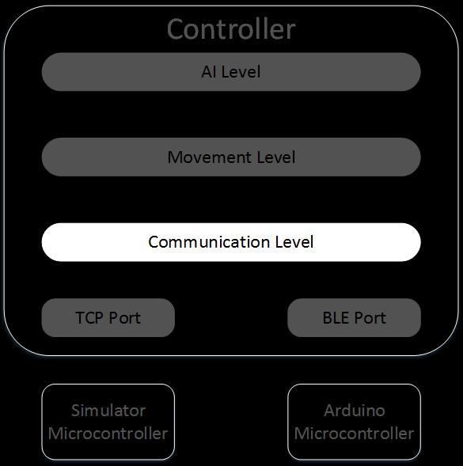
Communication Level
Facilitates Communication
Monitors Status
Listens for New Connections

Slide 13
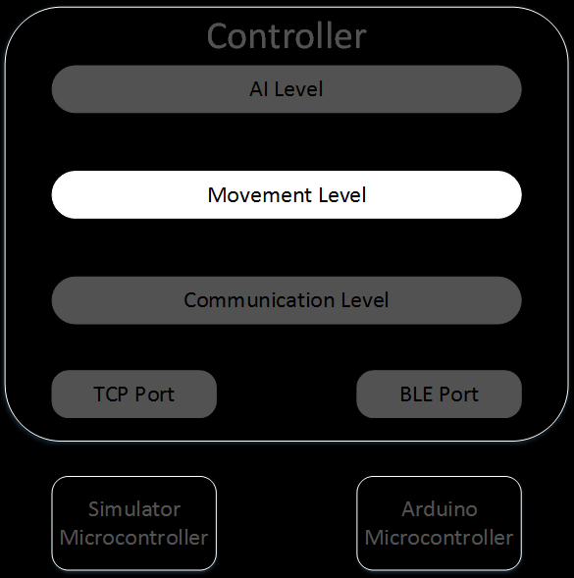
Movement Level
Receives Sensor Information
Determines Robot Locations
Maintains World Model

Slide 14
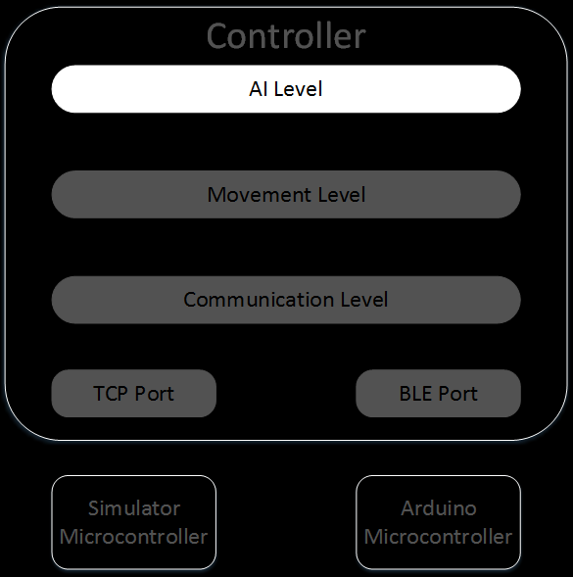
AI Level
Analyzes World Model
Plans Paths to Goal State
Issues Movement Commands

Slide 15
Current Progress

Slide 16
Achieved Goals
Robots
Cameras
Controller

Slide 17
Robots
Simple Library
Basic Movement
Simulator Model

Slide 18
Cameras
Trained to Detect Objects
Strategy for Training Cameras
Defined API

Slide 19
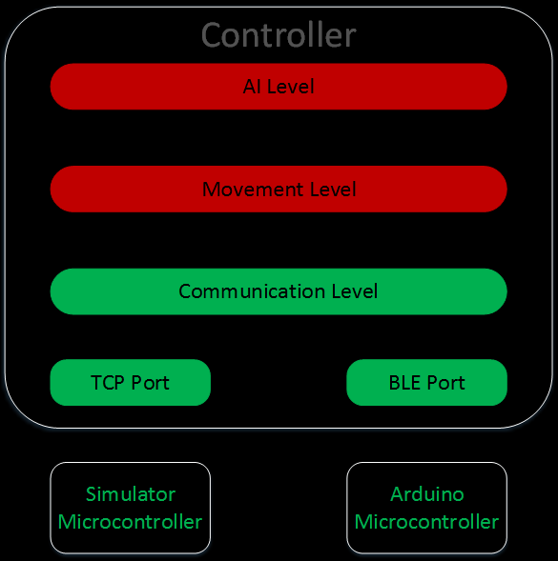
Controller

Slide 20
Controller
https://youtu.be/B7y5TiiGJSY

Slide 21
Roadmap

Slide 22
January 3
Determine AI Planning Algorithm

Slide 23
January 17
Finalized World Model

Slide 24
February 28
Enhanced Robot Internals Library
Enhanced Communication Level
First Iteration of AI Algorithm

Slide 25
April 18
Final AI Algorithm
Extra Formations (Stretch)

Slide 26
Q & A

